Slide 1
File Systems

Slide 2
Main Points
File layout
Directory layout

Slide 3
File System Design Constraints
For small files:
  Small blocks for storage efficiency
  Files used together should be stored together
For large files:
  Contiguous allocation for sequential access
  Efficient lookup for random access
May not know at file creation
  Whether file will become small or large

Slide 4
File System Design
Data structures
  Directories: file name -> file metadata
    Store directories as files
  File metadata: how to find file data blocks
  Free map: list of free disk blocks
How do we organize these data structures?
  Device has non-uniform performance

Slide 5
Design Challenges
Index structure
  How do we locate the blocks of a file?
Index granularity
  What block size do we use?
Free space
  How do we find unused blocks on disk?
Locality
  How do we preserve spatial locality?
Reliability
  What if machine crashes in middle of a file system op?

Slide 6
File System Design Options
 | FAT | FFS | NTFS
Index structure | Linked list | Tree (fixed, assym) | Tree (dynamic)
granularity | block | block | extent
free space allocation | FAT array | Bitmap (fixed location) | Bitmap (file)
Locality | defragmentation | Block groups + reserve space | Extents Best fit defrag

Slide 7
Named Data in a File System

Slide 8
Microsoft File Allocation Table (FAT)
Linked list index structure
  Simple, easy to implement
  Still widely used (e.g., thumb drives)
File table:
  Linear map of all blocks on disk
  Each file a linked list of blocks

Slide 9
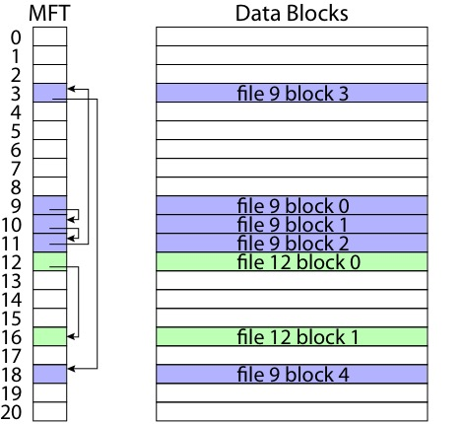
FAT

Slide 10
FAT
Pros:
  Easy to find free block
  Easy to append to a file
  Easy to delete a file
Cons:
  Small file access is slow
  Random access is very slow
  Fragmentation
    File blocks for a given file may be scattered
    Files in the same directory may be scattered
    Problem becomes worse as disk fills

Slide 11
Berkeley UNIX FFS (Fast File System)
inode table
  Analogous to FAT table
inode
  Metadata
    File owner, access permissions, access times, …
  Set of 12 data pointers
  With 4KB blocks => max size of 48KB files

Slide 12
FFS inode
Metadata
  File owner, access permissions, access times, …
Set of 12 data pointers
  With 4KB blocks => max size of 48KB files
Indirect block pointer
  pointer to disk block of data pointers
Indirect block: 1K data blocks => 4MB (+48KB)

Slide 13
FFS inode
Metadata
  File owner, access permissions, access times, …
Set of 12 data pointers
  With 4KB blocks => max size of 48KB
Indirect block pointer
  pointer to disk block of data pointers
  4KB block size => 1K data blocks => 4MB
Doubly indirect block pointer
  Doubly indirect block => 1K indirect blocks
  4GB (+ 4MB + 48KB)

Slide 14
FFS inode
Metadata
  File owner, access permissions, access times, …
Set of 12 data pointers
  With 4KB blocks => max size of 48KB
Indirect block pointer
  pointer to disk block of data pointers
  4KB block size => 1K data blocks => 4MB
Doubly indirect block pointer
  Doubly indirect block => 1K indirect blocks
  4GB (+ 4MB + 48KB)
Triply indirect block pointer
  Triply indirect block => 1K doubly indirect blocks
  4TB (+ 4GB + 4MB + 48KB)

Slide 16
FFS Asymmetric Tree
Small files: shallow tree
  Efficient storage for small files
Large files: deep tree
  Efficient lookup for random access in large files
Sparse files: only fill pointers if needed

Slide 17
FFS Locality
Block group allocation
  Block group is a set of nearby cylinders
  Files in same directory located in same group
  Subdirectories located in different block groups
inode table spread throughout disk
  inodes, bitmap near file blocks
First fit allocation
  Small files fragmented, large files contiguous

Slide 19
FFS First Fit Block Allocation

Slide 20
FFS First Fit Block Allocation

Slide 21
FFS First Fit Block Allocation

Slide 22
FFS
Pros
  Efficient storage for both small and large files
  Locality for both small and large files
  Locality for metadata and data
Cons
  Inefficient for tiny files (a 1 byte file requires both an inode and a data block)
  Inefficient encoding when file is mostly contiguous on disk
  Need to reserve 10-20% of free space to prevent fragmentation

Slide 23
NTFS
Master File Table
  Flexible 1KB storage for metadata and data
Extents
  Block pointers cover runs of blocks
  Similar approach in linux (ext4)
  File create can provide hint as to size of file
Journalling for reliability
  Next chapter

Slide 24
NTFS Small File

Slide 25
NTFS Medium-Sized File

Slide 26
NTFS Indirect Block

